Slide 1

Client Merge Training
Archdiocese of Houston – Galveston

Slide 2

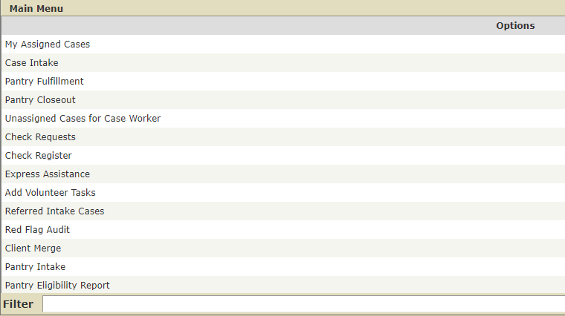
Only Record Manager can perform client merge. Make sure that you have been assigned the necessary roles.

Slide 3
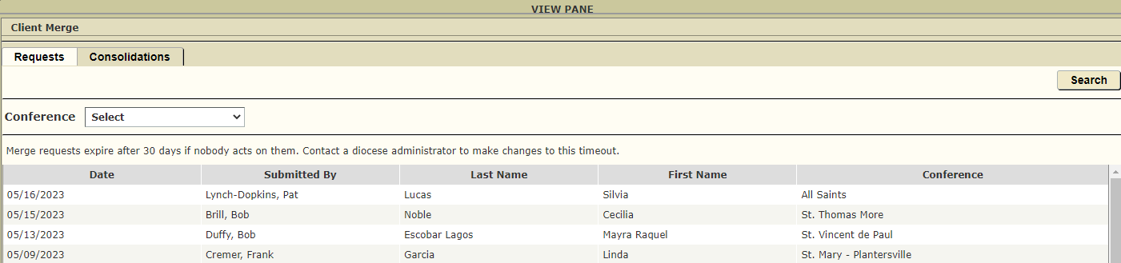
Click on the line with the client to be merged.

Slide 4
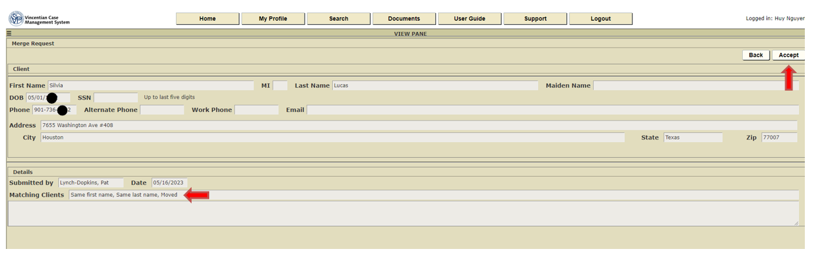
Review the reasons provided and click the Accept button

Slide 5
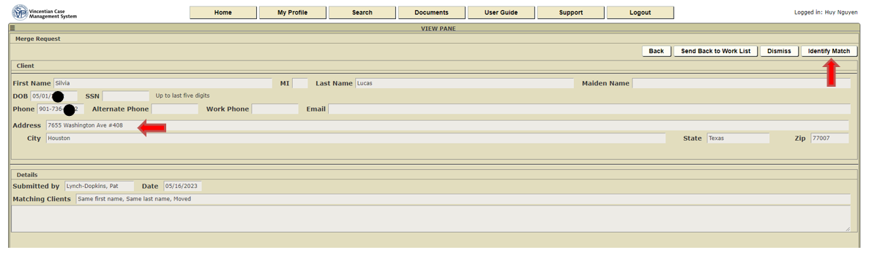
Review the address, DOB and phone number. You will need these information to determine
a match in the next step. Click the Identify Match button

Slide 6
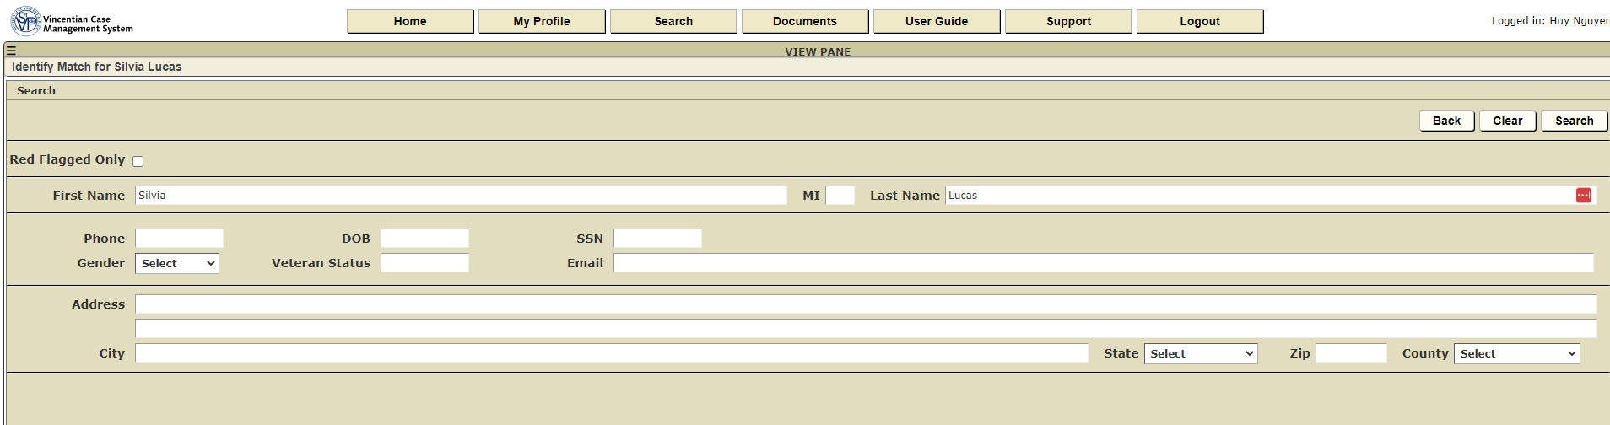
Type in the First and Last name. Click the Search button

Slide 7
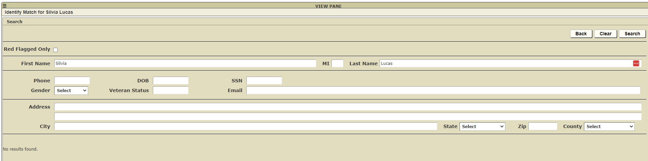
Scenario #1 – No duplicate found
Only message “No results found.” is displayed. This indicates no match with same first and last
name was found. One option is to Clear the result and start a new search using either phone
Number or DOB. If no result is found, click the Back button.

Slide 8
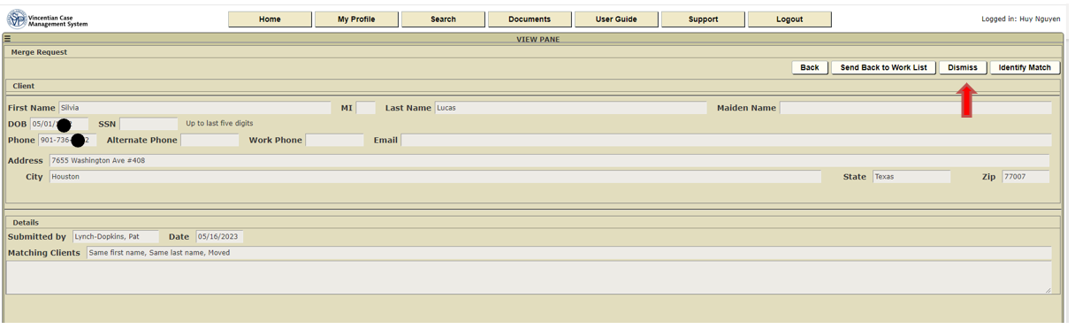
Click the Dismiss button since no duplicate was found. You will be return to the
Client Merge queue to work on the next request. You can also search in Clients to
make sure no duplicates exist.

Slide 9
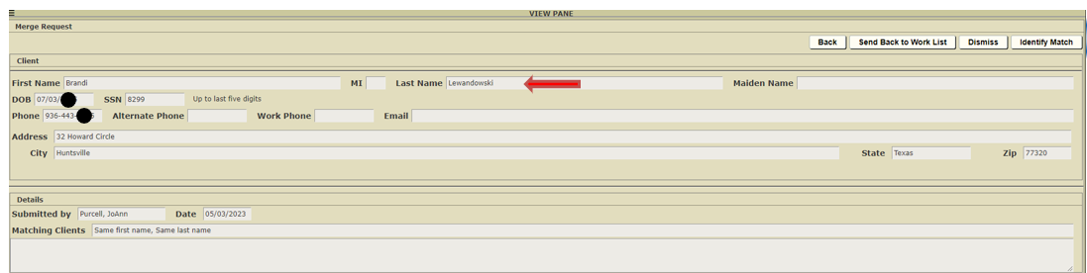
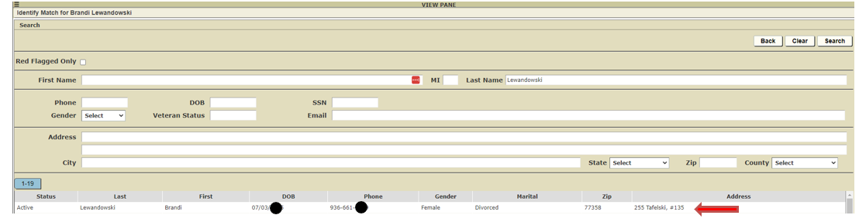
Scenario #2 – Duplicate found
Click on the matching record.

Slide 10
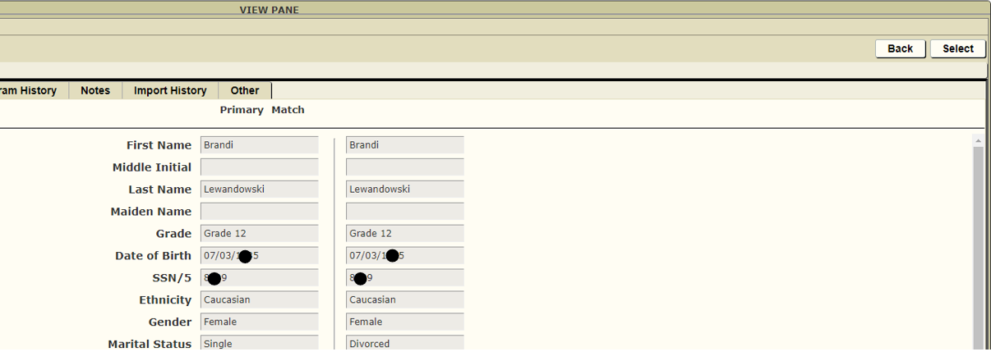
Verify that these are the two records that need to be merged. Click on Select to proceed.

Slide 11
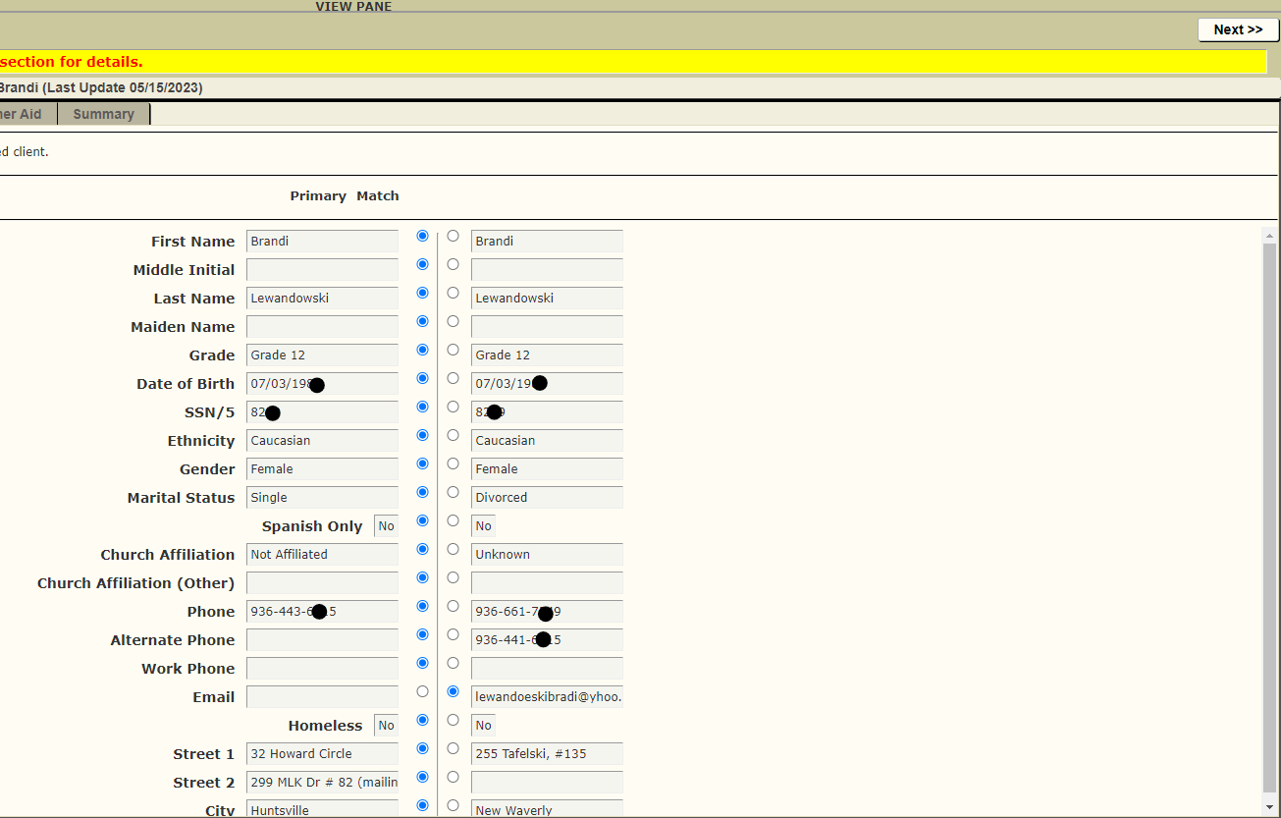
Place the blue button on the fields to be kept or merged into. Click on Next to proceed.

Slide 12
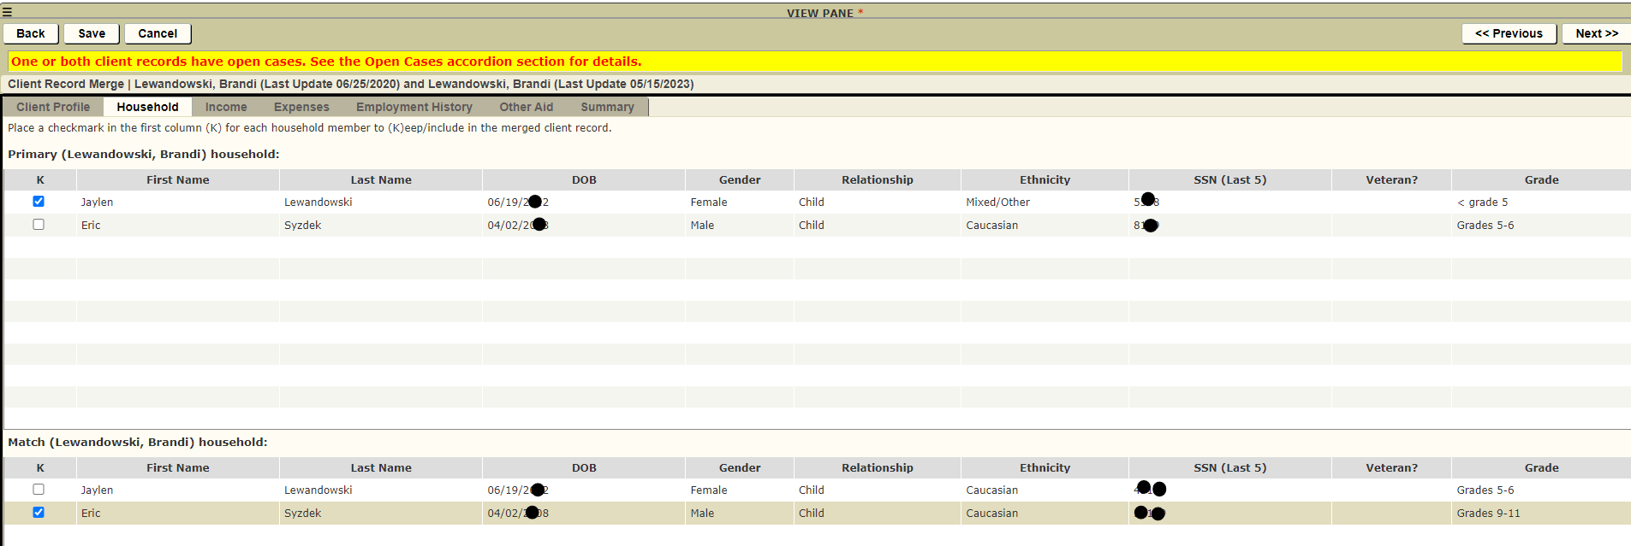
Check the box on the lines to be kept or merged into. Click on Next to proceed.

Slide 13
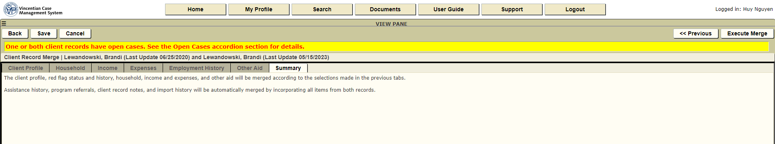
After all the data to be merged have been specified, click on Execute Merge button to execute the merge.

Slide 14
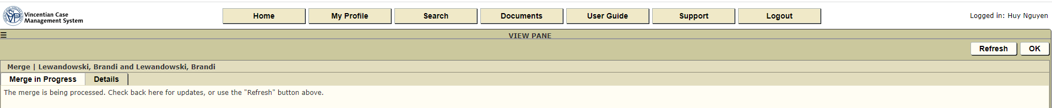
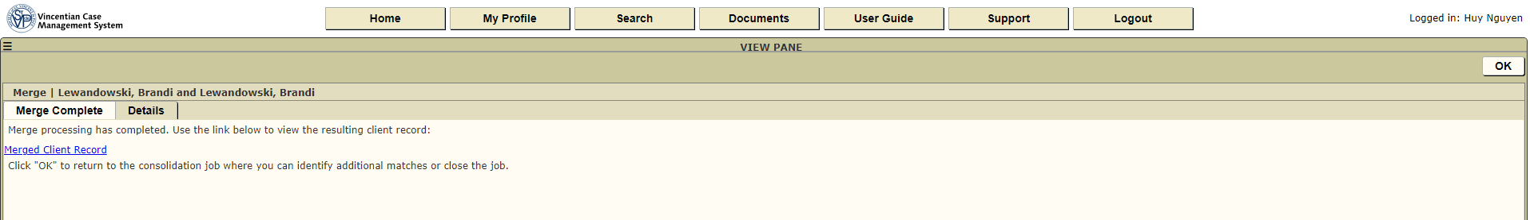
These steps are needed to properly close out the merge request. Wait about 5 minutes and check on the merge status by clicking the Refresh button. It will tell you when the merge is completed.
Once the merge processing has completed, clicking the OK button to return to the queue. This will allow you to continue to merge another duplicate in case there are multiple duplicates for the same clients.

Slide 15
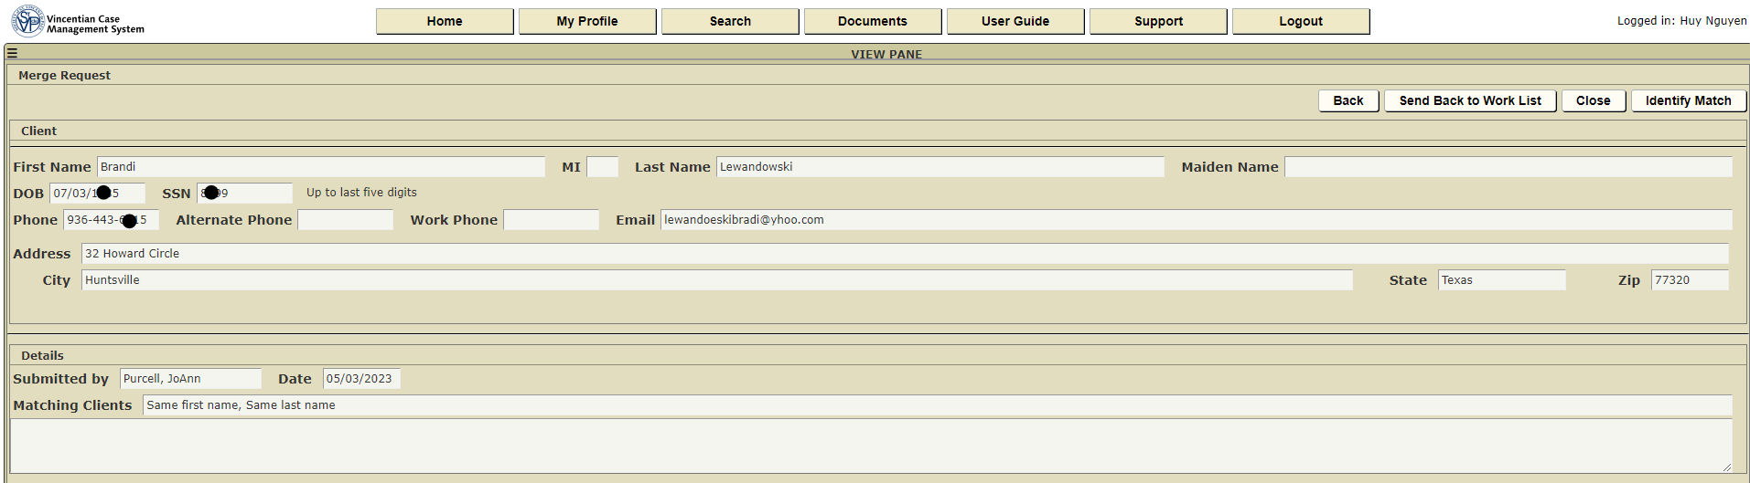
If there are additional duplicates for the same client that need to be merged, click on Send Back to Work List and repeat the merge process. If there is no more duplicates to be merge and you are done with the merge request, click on the Close button to close the merge request.

Slide 16
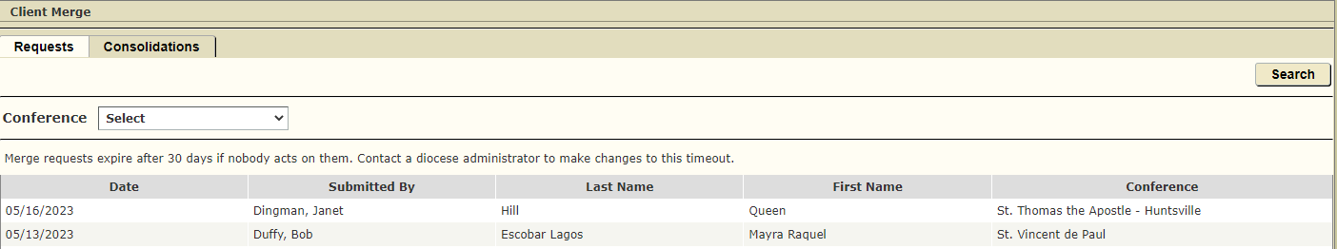
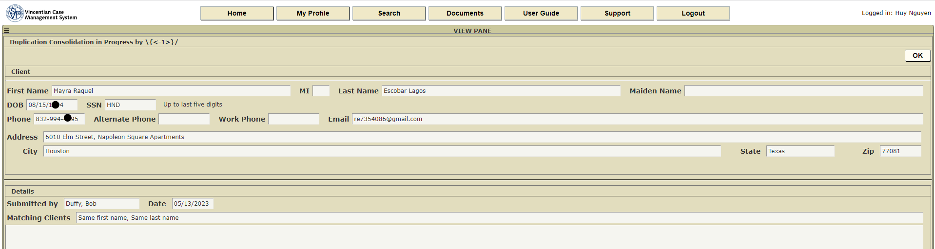
If the merge request is not close out properly after you have completed the merging, the request will remain in the queue for up to 30 days. However, you will not be able to work on the request as its status will show as “in progress”. Click on the OK button to exit. The request will be removed from the queue after 30 days.

Slide 17
Questions?

